Slide 1
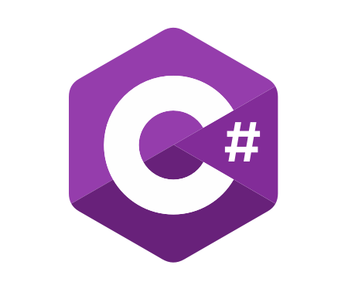
C# OOP
Course Introduction
SoftUni Team
Technical Trainers
Software University
https://softuni.bg/

Slide 2
Table of Contents
Course Objectives
Training and Team
Course Organization
Course Infrastructure
Evaluation Criteria

Slide 3
Have a Question?
sli.do
#csharp-advanced

Slide 4














SoftUni Diamond Partners

Slide 5

Educational Partners

Slide 6

Course Objectives

Slide 7
Why OOP?
Object-oriented programming is an important paradigm
Anyone involved in software development should be familiar with OOP and Object-oriented modelling
All modern languages are either object-oriented or support classes and objects
Modern frameworks, libraries and APIs are object-oriented
OOP is a basic requirement for starting a job as developer
7

Slide 8
Course Program
Inheritance
Encapsulation
Interfaces and Abstraction
Polymorphism
Exception Handling
SOLID
Reflection and Attributes
Unit Testing
Mocking and Test Driven Development
Design Patterns
Workshop
Exam Preparation

Slide 9
Practical Exam
2 practical problems for 4 hours:
Create a simple project that:
Follows the OOP principles
Implements functionality based on a description
Test a provided class
Automated judge system with real-time feedback
Upload a zip project to the judge system
9

Slide 10
Theoretical Exam
You will have 30 minutes once you enter
Multiple-choice with one correct answer
English
Automated quiz system
Available during the practical exam and 30 minutes after it
You can submit your answers just one time
Advice: Start it when you finish the practical exam
10

Slide 11

The Team

Slide 12
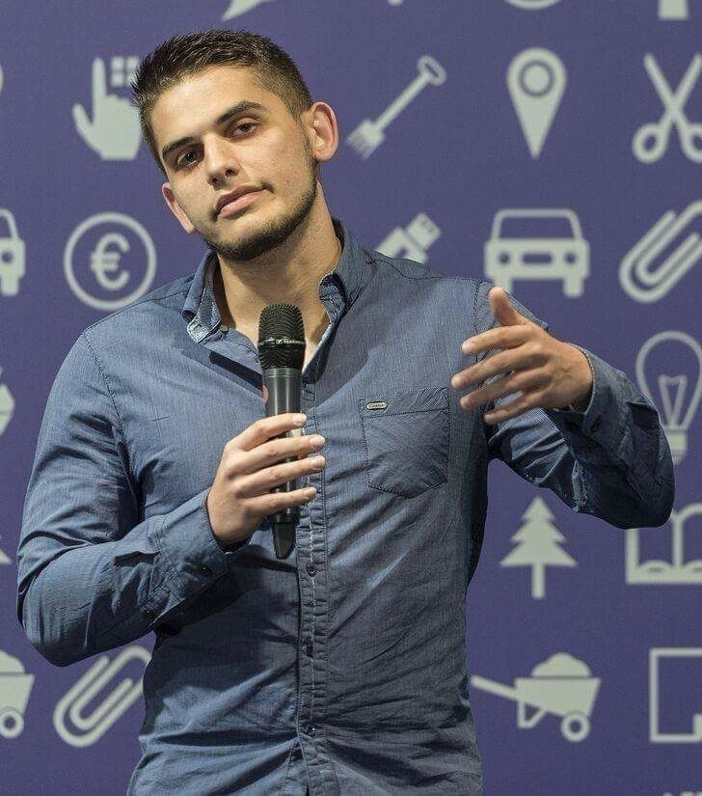
Viktor Dakov
Manager, Software Engineering @ Nuvolo
Worked at Amazon
John Atanasoff award
Participated in many programming contests
9+ Years of Experience as a Developer

Slide 13
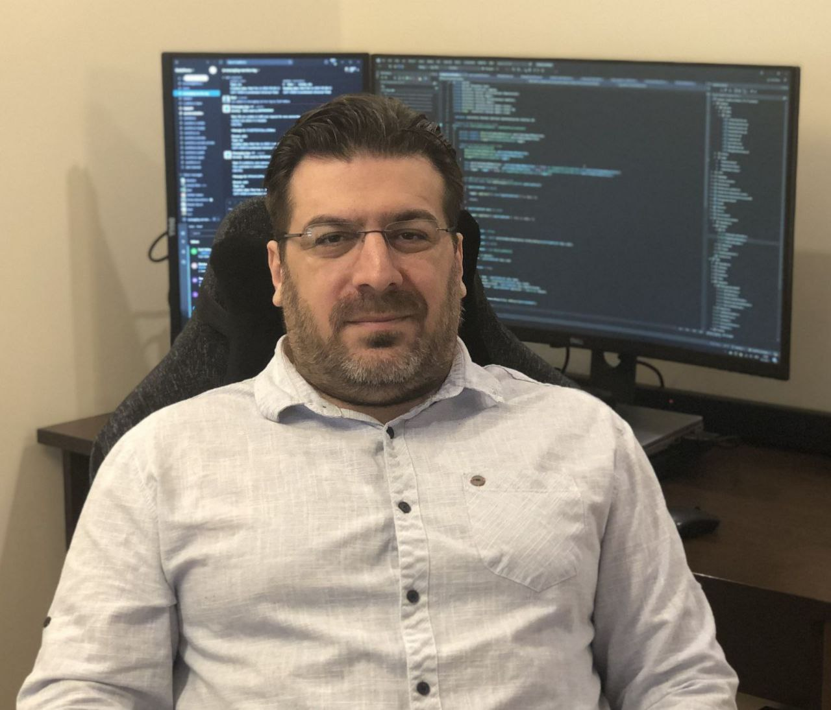
Georgi Inkov
C# Web Developer
8 years experience in .NET ecosystem
Graduated the first class @ SoftUni
Worked in Cashwave, Vivacom & Fourth
Now works as a back-end developer
@ Excitel Technology

Slide 14

Course Organization

Slide 15
C# OOP Course – Timeline
21-Feb-2023
08-Apr-2023
18-Apr-2023
C# OOP
6 weeks * 4 times/week
15 credits
Start: 21-February-2023
Theoretical Exam: 08-April-2023
Practical Exam: 08-April-2023
Theoretical Exam Retake: 18-April-2023
Practical Exam Retake: 18-April-2023

Slide 16

Homework Assignments & Exercises
Your homework is mainly work in class
Lesson days → slides + live demos + exercises
Exercise days → only exercises
How to submit your homework?
Submit in the judge system
Do your homework when it's due
Assignments pile up quickly

Slide 17


SoftUni Certificate
Practical Exam 100%
Homework 5% (bonus)
Evaluation
17

Slide 18
CPE Certificate
Practical Exam
Theoretical Exam
Evaluation
18

Slide 19



Course Web Site, Forum and FB Group
Official web site:
Official discussion forum:
Official Facebook group:
https://softuni.bg/trainings/3958/csharp-oop-february-2023
https://softuni.bg/forum/categories/15/csharp-oop-advanced
https://www.facebook.com/groups/CsharpAdvancedJanuary2023

Slide 20


Learn to Search in Internet
The course assignments require to search in Internet​
This is an important part of the learning process​
Some exercises intentionally have no hints​
Learn to find solutions!​
Software development includes ​ everyday searching and learning​
No excuses, just learn to study!​
Developers learn new technologies, tools, languages every day!​

Slide 21
Questions?
Notes:
21

Slide 22
Trainings @ Software University (SoftUni)
Software University – High-Quality Education, Profession and Job for Software Developers
softuni.bg, about.softuni.bg
Software University Foundation
softuni.foundation
Software University @ Facebook
facebook.com/SoftwareUniversity
Software University Forums
forum.softuni.bg
22
Notes:
22

Slide 23

License
This course (slides, examples, demos, exercises, homework, documents, videos and other assets) is copyrighted content
Unauthorized copy, reproduction or use is illegal
© SoftUni – https://about.softuni.bg
© Software University – https://softuni.bg
Notes:
23

